Slide 1
Instagram Influencer
RECOMMENDER SYSTEM
Group 5
Samii Shabuse, Savit Tumuluri, Han Truong

Slide 2
RECOMMENDER SYSTEM
DATA
TABLE of
CONTENT
METHODS &
MODELS
NEXT STEPS
RESULTS &
EVALUATION

Slide 3
CONTENT STRATEGY
Objective
“Given an influencer’s past posts, what type of content should they try next to get good engagement?”
evening + medium_caption + few_hashtags + not_ad + image

Slide 4
USER: an @instagram_influencer
ITEMS: content strategies
IMPLICIT FEEDBACK: Engagement
OUTPUT: Top-N Recommendations
DEFINE the
SYSTEM
Example
“ Given @some_fashion_creator’s
1,200 likes & 45 comments on past posts, they should try the strategy
morning + short_caption + no_hashtags + not_ad + image ”

Slide 5
Pipeline Overview
Raw metadata
Feature Engineering
Strategy Labels
Evaluation
Train/Test Split
Models
Top-5 Recommendations
Mode
-=
Mode

Slide 6
DATA OVERVIEW
Instagram Influencer Dataset
Scale & Categories
Feature Engineering
Dataset
Massive Scale: Over 10M post metadata records.
Note: We only used at most 100,000 posts
Selected Categories:
Fashion (11,911 influencers)
Travel (4,210 influencers)
Food (3,565 influencers)
Beauty (1,542 influencers)
Raw Data: Follower counts, post likes, comments, and JSON post metadata.
Engineered “Strategy” Label:
We combine 5 variables into a single strategy item for the recommender:
Time of Day + Media Type + Caption Length + Hashtag Count + Ad Status
Source: Official Instagram Influencer Dataset
Scope: 33,935 unique influencer profiles
Breadth: Spans 11 distinct content categories

Slide 7
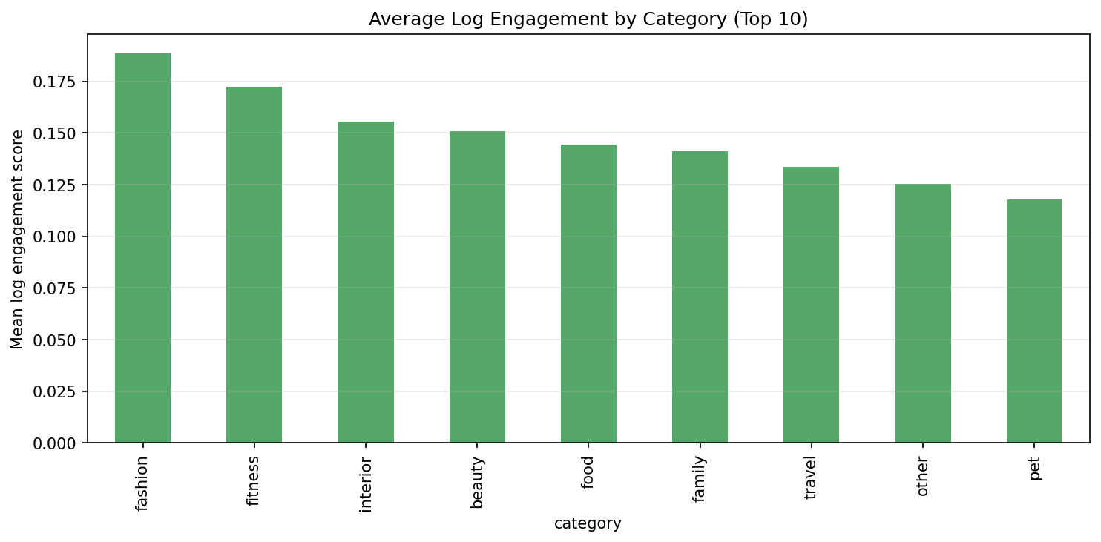
ENGAGEMENT METRIC
Pseudo-Ratings
Quintile Ranking: Convert continuous scores into pseudo-ratings (1 to 5) for each influencer.
Defining a “hit":
Rank all user's posts against their own history
Only posts with rating = 5 are flagged as “relevant" for the test set
If model recommends a 5-scored strategy → successful
Formula
Raw Engagement: prioritize high-effort interactions
Raw = Likes + (2 x Comments)
Logarithmic Normalization: scale the score against the user’s follower count to ensure fairness
Engagement Score = log1p(Raw) / log1p(followers)

Slide 8
Models

Slide 9
MODELS: BASELINES
GLOBAL BASELINE
CATEGORY BASELINE
Core Logic: Recommends strategies based on overall performance across the entire training dataset
Calculation: Compute global mean engagement score for each strategy
Personalization: None - same Top 5 recommendations regardless of their niche
Core Logic: Recommends what performs best within an influencer's community
Calculation: Compute mean engagement score within influencers' profile category
Personalization: Segment-based

Slide 10
MODELS: COLLABORATIVE
How Recommendations are Generated
Context: A and B have highly correlated engagement across past strategies
The system recommends B's top-performing strategies to A
Core Logic
Recommends strategies by finding creators with similar audience interaction history
Mathematical Approach
Influencer-by-strategy interaction matrix using historical engagement scores
Cosine Similarity between users
Level of Personalization
High (User-Specific)

Slide 11
MODELS: CONTENT-BASED
How Recommendations are Generated
Map the linguistic profile of a creator's best-performing captions
Highlight strategies tied to posts with highly similar text patterns
Core Logic
Recommends strategies based on textual content and writing style of past posts
Mathematical Approach
Process historical post captions using TF-IDF
Level of Personalization
Very High (Content-Specific)

Slide 12
MODELS: HYBRID
Core Logic
Blend crowd-sourced predictive power of CF with
personal writing style patterns (content) of individual creator
The Ensemble Mechanism
Extract individual preference scores from each model
Compute a unified ranking score for each strategy
Hyperparameter Tuning
The balancing weight is optimized to find the perfect equilibrium between matching trends and maintaining individual content consistency
Why Hybrid Helps
Overcome data sparsity issues of CF
Avoid “filter bubble" repetition of content-based

Slide 13
EVALUATION
TIME-BASED DATA SPLITTING
Posts are sorted by publication timestamp for all creators
Training data: older 80% posts Testing data: most recent 20% posts
Real-world simulation:
avoid data leakage
mimic live app scenario (predict what to do next based entirely on history)
RANKING METRICS
Strategy in test set is marked as a successful “Hit" if it lands in the creator's top 20% of historical engagement
Evaluate models based on a list of 5 strategies using industry standard:
Precision@5
Recall@5
NDCG@5
Hit-Rate@5

Slide 14
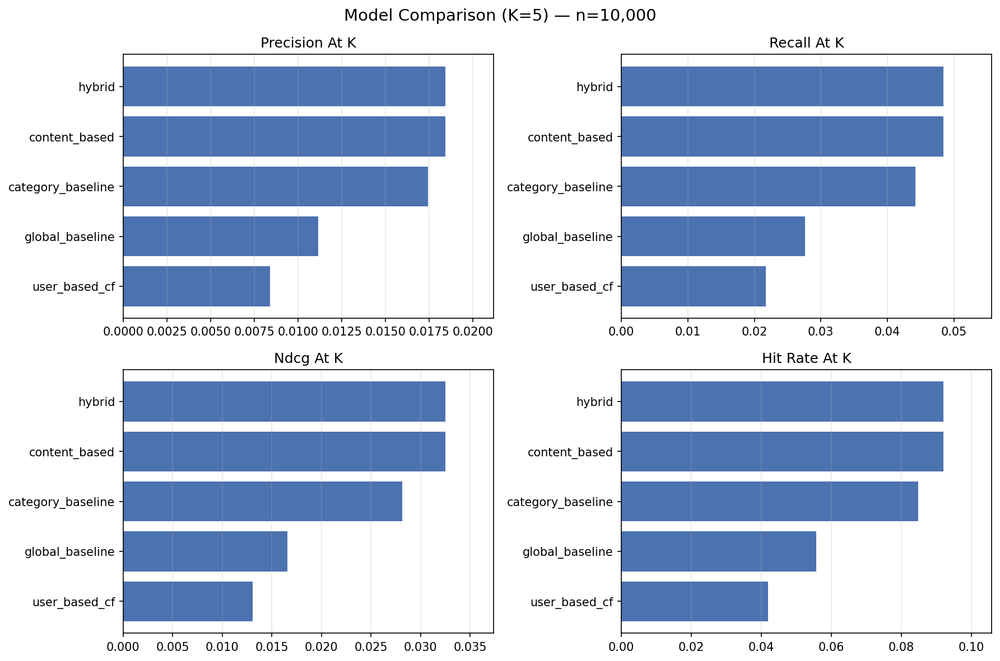
PERFORMANCE RESULTS
n = 10,000
The strongest personalized methods outperform the baselines at n=10,000
Content-based and Hybrid tie for the best ranking performance at n=10,000

Slide 15
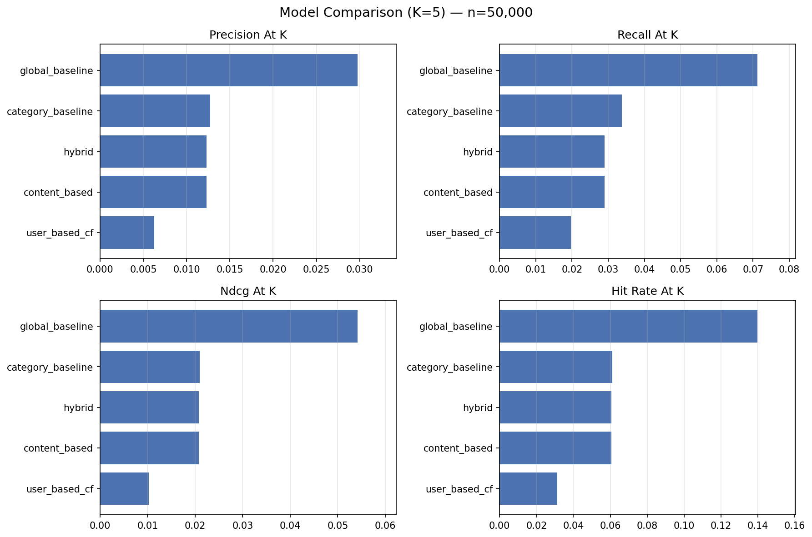
PERFORMANCE RESULTS
n = 50,000
The Global baseline becomes highly competitive at higher scale
Global viral trends shift model effectiveness

Slide 16
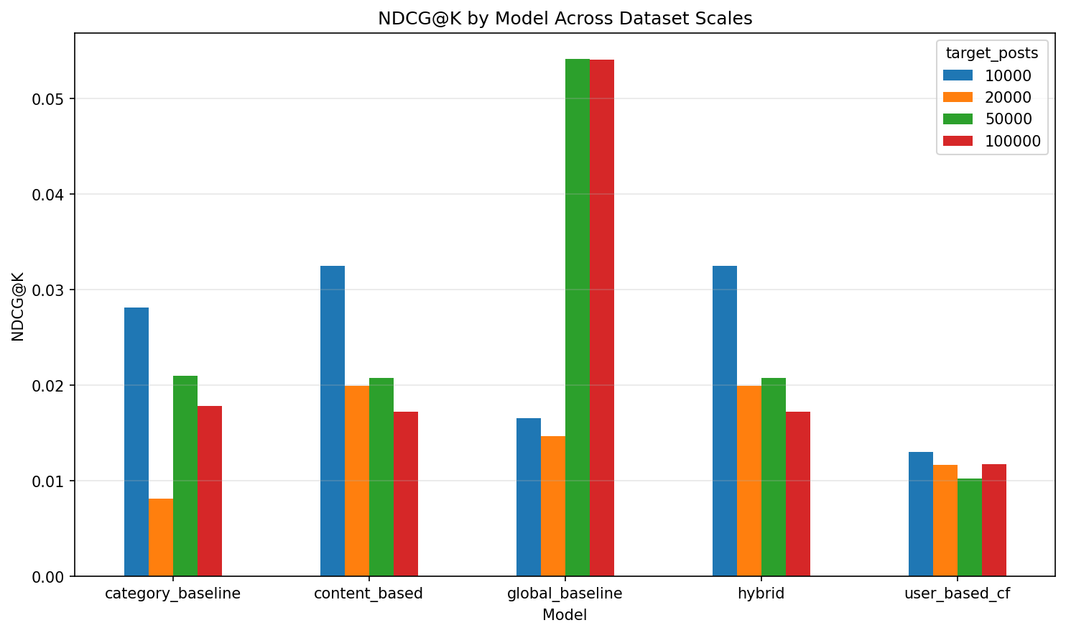
PERFORMANCE RESULTS
10k: Hybrid/Content NDCG@5 = 0.0325
10k: Hybrid/Content Hit Rate@5 = 0.0920
50k: Global NDCG@5 = 0.0542
NDCG
NDCG@5 rewards models that place highly relevant strategies in the top positions of Top-5
At low scale, content-based/hybrid personalization wins
Non-personalized Global baseline outperforms at high scale
→ When having a lot of data, huge platform trends matter more than a single creator's past history

Slide 17

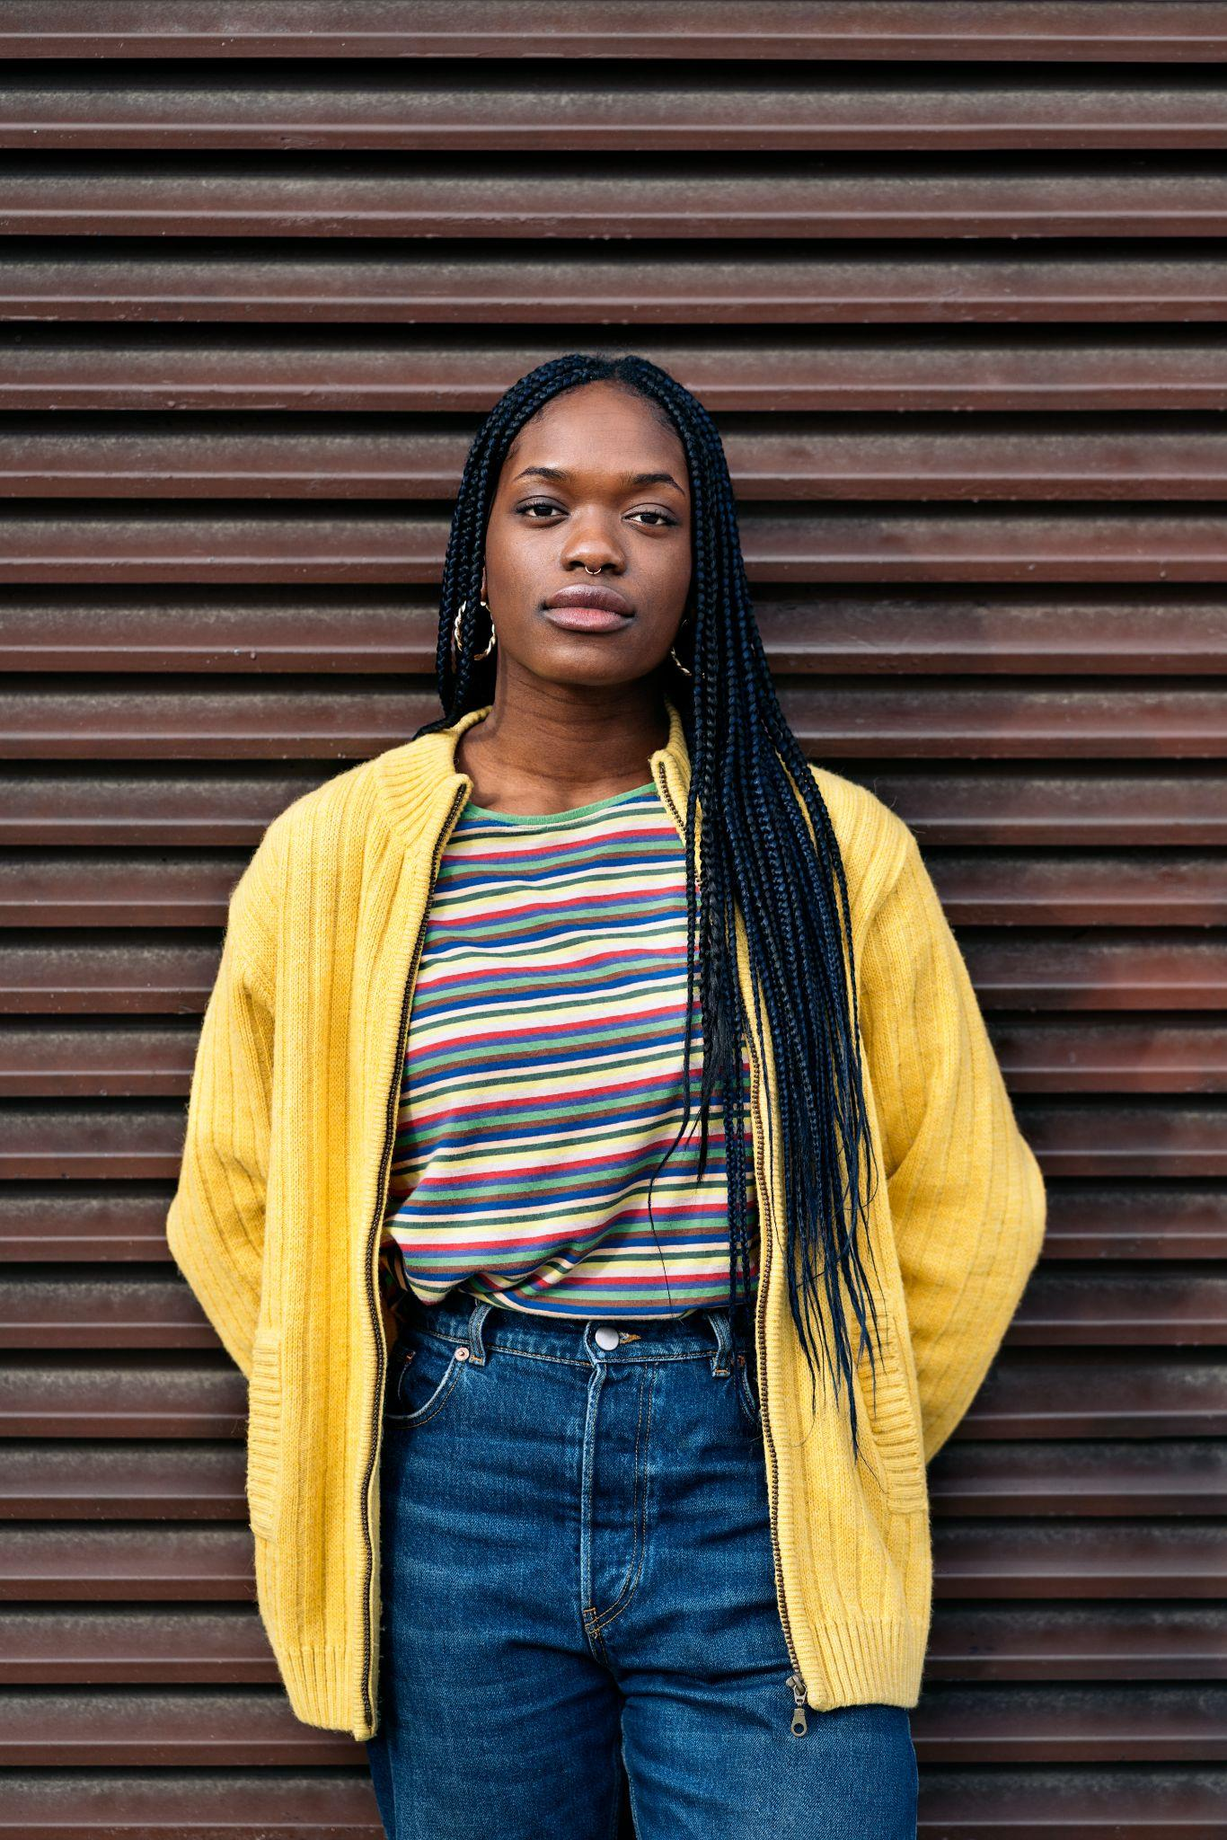
Niche: Family Followers: 404k
Historical style
Mostly night posts, video-heavy content, and all organic/non-ad posts. Stronger historical strategies tended to use video, longer captions, and no/few hashtags.
@jan_versteegh
SYSTEM RECOMMENDATION
evening + long_caption + few_hashtags + not_ad + video
Why it worked
The hybrid recommender ranked this strategy #1. In the held-out test set, this exact strategy appeared as one of the influencer’s top-engagement strategies, so it counted as a successful hit.
Synthetic benchmark examples generated from real influencer profiles; evaluated with time-based holdout.

Slide 18
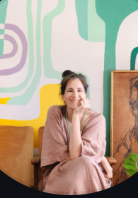
Historical Style
Mostly evening posts, image-heavy content, short or long captions, and few/many hashtags. All training posts were organic/non-ad.
System Recommendation
night + long_caption + few_hashtags + not_ad + image
@mila_jestcafe
Niche: Interior
Followers: 11.4K
Why it worked
The recommendation matched a high-performing strategy in the creator’s most recent held-out posts. The model kept the successful organic image format but shifted the strategy toward night posting, a long caption, and fewer hashtags.
Synthetic benchmark examples generated from real influencer profiles; evaluated with time-based holdout.

Slide 19
Limitations & Next Steps
1. Metadata only (no visuals)
Incorporate pre-trained visual models to analyze image and video features
2. Synthetic Local Data Scale
Upgrade from batch-processed offline recs to an active system that updates daily to capture instant trends
3. Correlation vs. Causation
Live A/B testing for the recommended strategies to track actual engagement growth and prove causal impact
4. Sparse matrix
Collaborative filtering struggles when creators have few strategy overlaps
Notes:
Metadata Only (No Visuals): The models rely strictly on text data (captions, hashtags, posting times) and completely ignore the actual image or video pixels, which are massive drivers of Instagram success.
→ Computer Vision Integration: Incorporate pre-trained visual models (like ResNet or CLIP) to analyze image aesthetics, color palettes, and video features alongside text metadata.
Synthetic Local Data Scale: Due to the massive 189 GB size of the raw dataset, local testing was constrained to synthetic data generated from real profile structures rather than full real post-history runs.
→ Real-Time Streaming Recommendations: Upgrade from batch-processed offline recommendations to an active system that updates daily to capture instant, hyper-viral platform trends.
Correlation vs. Causation: A high engagement score simply shows a pattern that worked in the past. It does not guarantee that using the strategy causes virality, as external real-world trends or creator fame are unmeasured factors.
→ Live A/B Testing: Deploy the top recommended strategy strings to a test cohort of real influencers to monitor actual engagement growth and prove true causal impact.

Slide 20
THANK YOU

